Slide 1
Summer School 2020
Arts & Letters HR/FO Process
March 17, 2020

Slide 2
Common Language
OCCI- Off Campus Credit Instruction
AY- Academic Year (August 16- May 15)
AN- Annual Year
  12 month AN- typically starts July 1 or August 16, but dates can vary
  Semester by semester AN- typically August 16-December 31 and/or January 1-May 15
TS- Tenure System Faculty
FT- Fixed Term Faculty
AS- Academic Specialists
Continuing Faculty- Non-Fixed Term Academic Specialists

Slide 3
Common Language Continued
Seated course- typically an on-campus class, held in a brink and mortar building
RO- Registrars Office
US20- 2020 Summer Semester
Session A- typically May 16-June 30
Session B- typically July 1-August 15
Session C- Any dates between May 16 and August 15
CDW- Cost Distribution Worksheet
FTM- Fixed Term Memo
SCH- Student Credit Hours

Slide 4
Summer Instruction Timeline
November 8, 2019: Work Copy due to RO
November 5, 2019: Provost US20 Funding Request sent to the College
December 9, 2019: Department’s Provost US20 Funding Request due to College
January 16, 2020: Notification of Provost US20 Funding Approval
February 24, 2020: HR open AY Summer SAP form in EBS
March 2020: Summer Procedures Memo from CAL

Slide 5
Provost Funded Courses
Departments submit requests, via the Dean’s Office, for US seated course instruction to be paid by the Provost
If approved, instruction fees are charged to College account GP100014 during the FAS appointment process
These course must meet the RO minimum 15-10-5, or they will be cancelled
Revenue cannot be collected from these courses
Section numbers are typically 100-300

Slide 6
Provost Funded Courses Continued
At this time, it is unclear if the MSU will hold seated courses in the summer
If there are no seated courses this summer, will the courses currently planned be moved to on-line?
If those courses are moved to on-line, would the Provost still be willing to pay for the instruction costs?

Slide 7
OCCI Courses- Timing
The revenue cycle is May 16 to May 15
  The revenue from courses held in US19, FS19 and SS20 will be allocated to CAL in the FY21 Budget Load
  The College will reconcile the courses in FS20, and allocate revenue to the units
Revenue from courses held in US20, FS20 and SS21 will be allocated to unit in FS21.

Slide 8
OCCI Courses- Instruction
US Instruction fees are paid from each unit’s OCCI account
After summer semesters is complete, all appointments are reconciled by the College. The College gives the units 25% of instruction costs.
  Eg if instruction costs are $10,000, the unit pays the instructor $10,000, then CAL give the unit $2,500
Section numbers are typically 730-749

Slide 9
OCCI Courses- Revenue
Units receive revenue if the student is only enrolled in an on-line course
  If the student is enrolled in an online course and a seated course no revenue to generated
The amount of revenue depends on the tuition amount of the type of student enrolled
  resident, non-resident, undergraduate level 1 or 2, undergraduate level 3 or 4, grad, lifelong learner, etc.
25% of the revenue is kept centrally
An additional 25% is kept by the College
The units receive the remaining balance
  This ends up being 56.25%

Slide 10
OCCI Courses- Revenue Example
If a 3 credit ATD course has 10 in-state juniors, 7 of whom are only taking on-line courses, at a tuition rate of $555, the revenue from those students is $11,655.
$2,913.75 is kept Centrally
$2,185.31 is kept by the College
$6,555.94 goes to the unit

Slide 11
OCCI Courses- Breakeven
The number of on-line only students required to cover instruction costs
To calculate:
  1. find the per credit tuition cost for the lowest cohort of student (undergrad/lower level/resident)
  2. Reduce the tuition by 56% (25% (Central) and 25% again (CAL))
  3. find the # of credits per course.
  4. Divide by the instruction rate:
  Instruction Cost/res UG1 * # of credits *56% = breakeven enrollment
$7,612/$809.76 = 9.4
Always Round up
This assumes that none of the students are taking seated courses
To be safe use the 15-10-5 course minimum set by the RO

Slide 12
CAL Memo Review
Same IAH Process as US19
  Units process IAH appointments for their faculty
  Use Unit Org Code and IAH account GA100323
  A list of IAH courses will be sent to unit with as much appointment detail as possible
Continuing appointments use the CDW as TS
Graduate students hired as GAs vs. AN (semester by semester) FT
  Use “Change an Existing Appointment/Assignment” drop down in EBS
  Session B hires will need a new I-9 due to break in service

Slide 13
Cost Distribution Worksheets
AN FT
AY FT
TS/Continuing
  Includes offer of employment
Fill out all GREEN areas on the calculation sheets
Sheets were made to auto fill, so don’t delete formulas
Attached CDW, as an Excel file, to all non-grad appointments

Slide 14
Appointment Dates
Provost funded courses stick to strict 5/16-6/30 and 7/1-8/15 appointment dates.
OCCI courses are more flexible- if possible, try to avoid overload payments by adjusting the appointment dates, but remember the dates in SAP must match the dates of the offer letter and FTM
Use session C on the CDW to calculate the employment percentage for non-traditional appointment dates

Slide 15
Overload Payments
Last year most summer overload was still in paper. It is unclear if the same is true this year (please let me know if you figure it out!)
The College needs to log all overload forms
Email a PDF of the overload form to summer@cal.msu.edu Do not send paper overload payments directly to Payroll

Slide 16
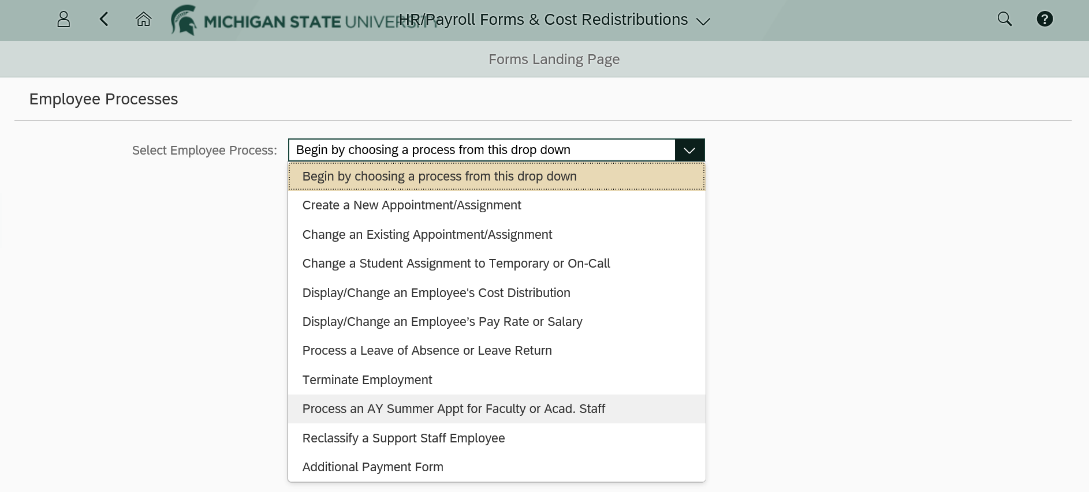
For AY FAS
In EBS, go to Actions, then HR/Payroll Form & Cost Redistribution

Slide 17
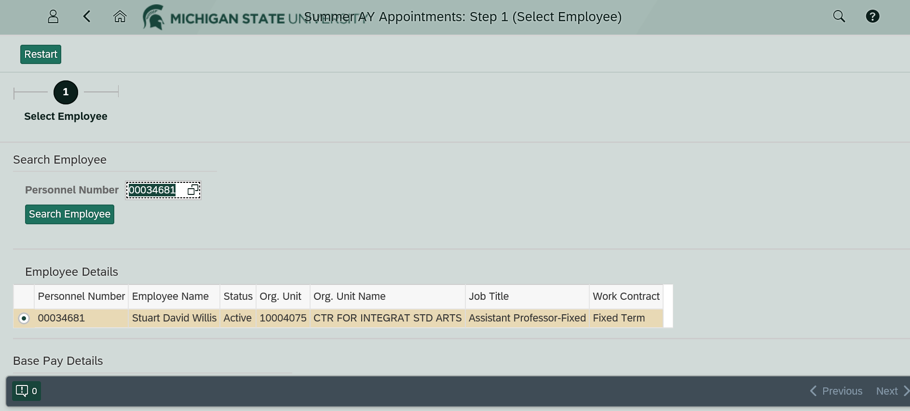
Search for FAS via Personnel Number, or by name, by clicking the double boxes.

Slide 18
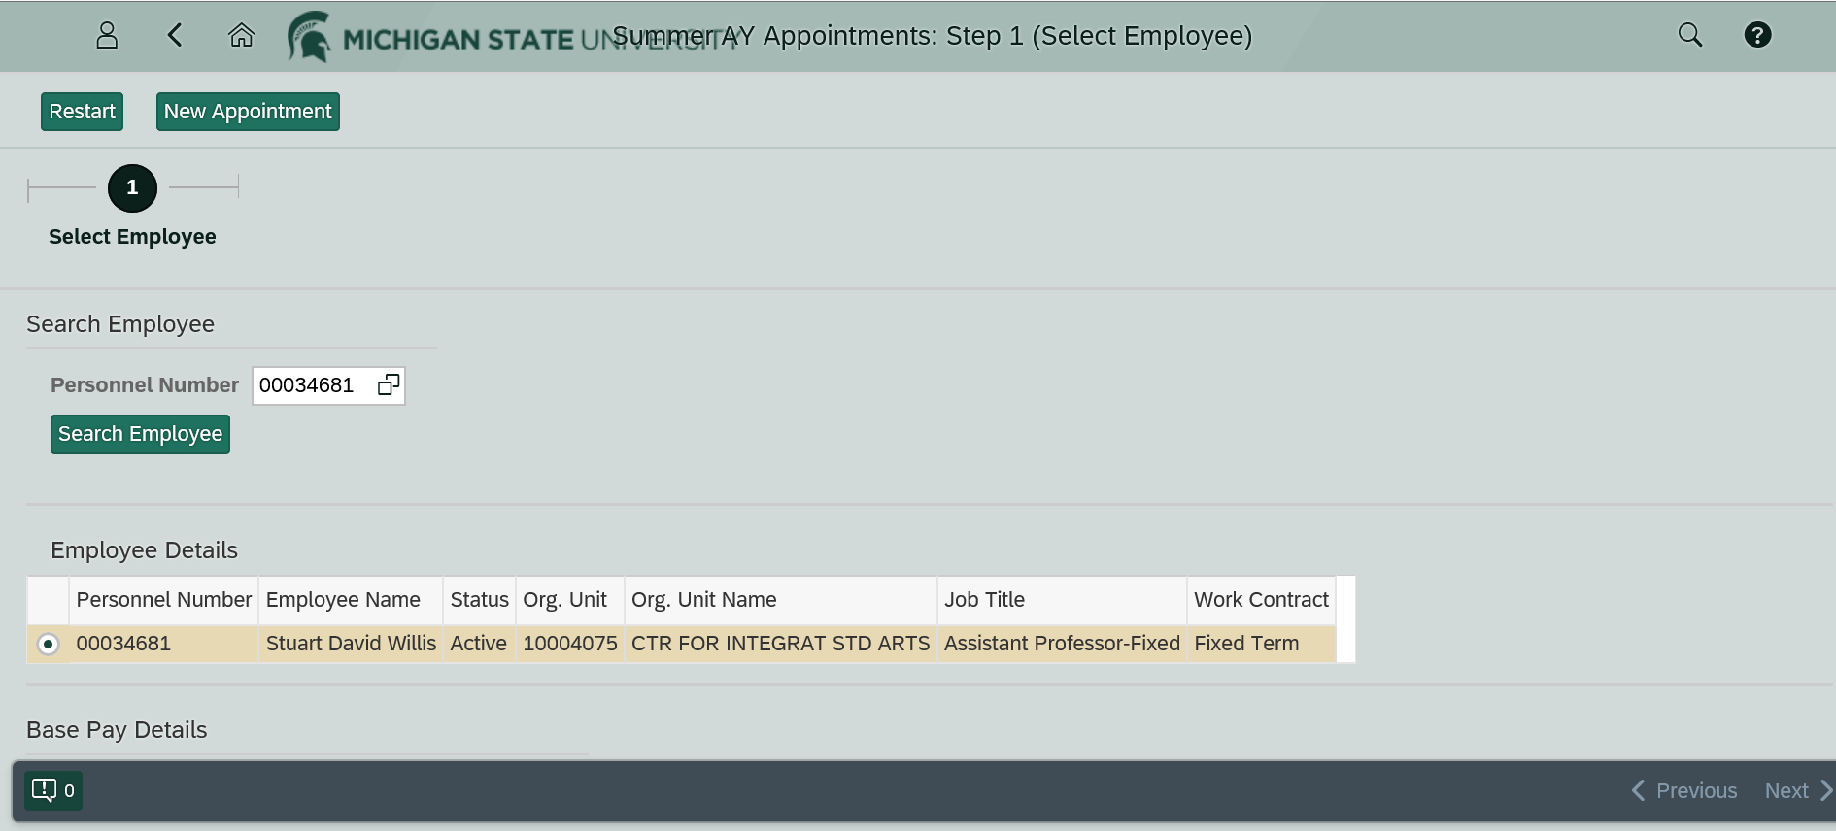
After searching for the employee, you have to hit “Search Employee” for the “New Appointment” button to appear

Slide 19
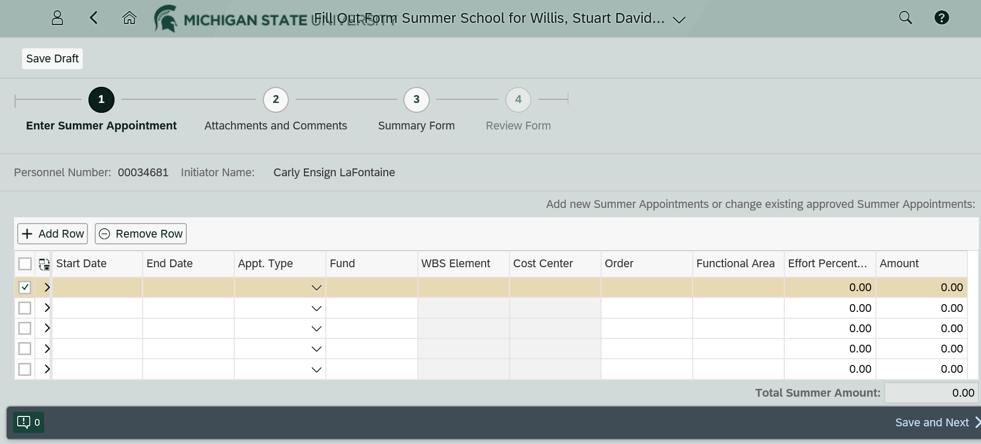
Enter the appointment details. These must match the offer letter and FTM

Slide 20
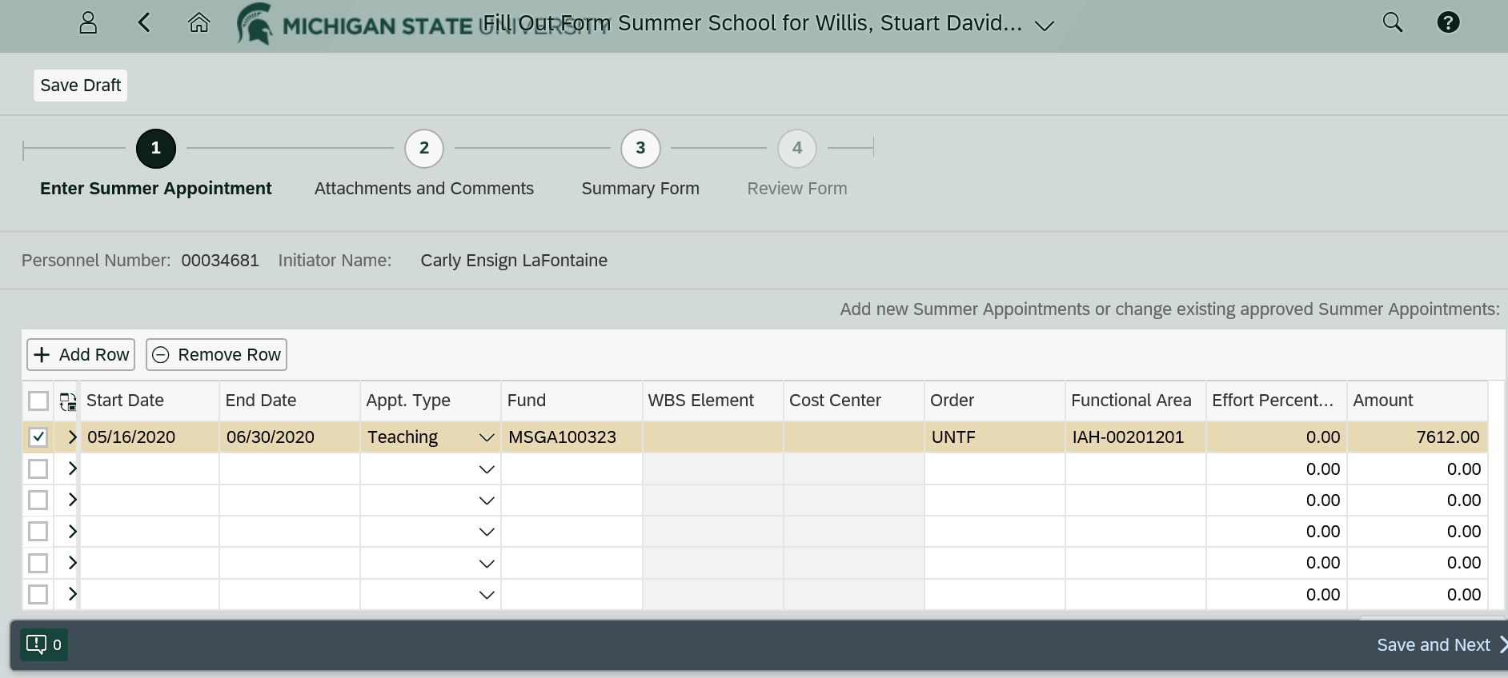
Order is “UNTF” or “NOUNTF”
Functional Area is required
Effort Percent will calculate after you hit “Save and Next” at the bottom

Slide 21
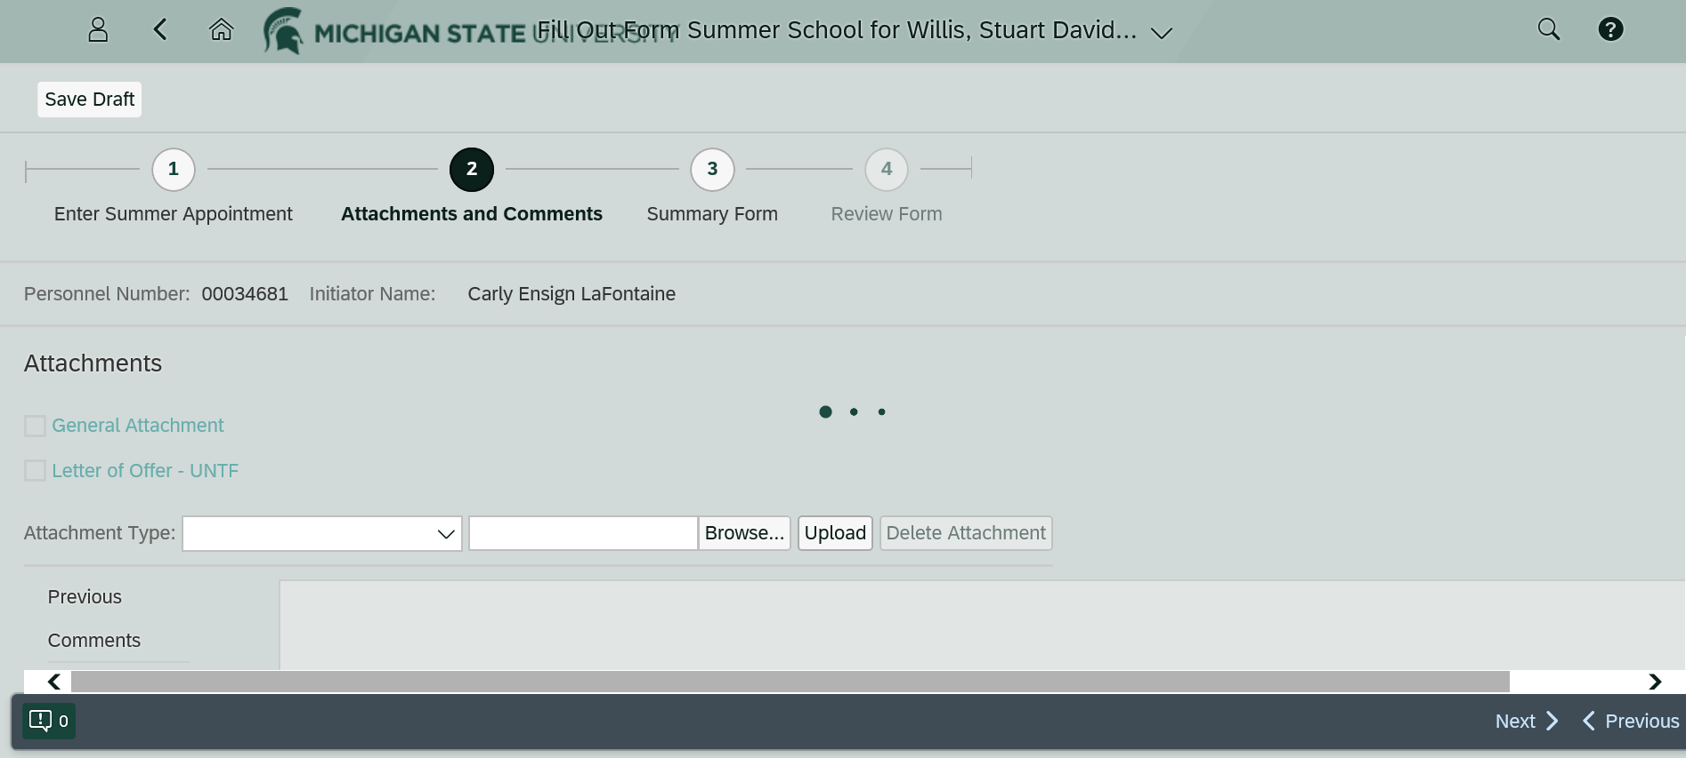
The General Attachment should be the CDW

Slide 22
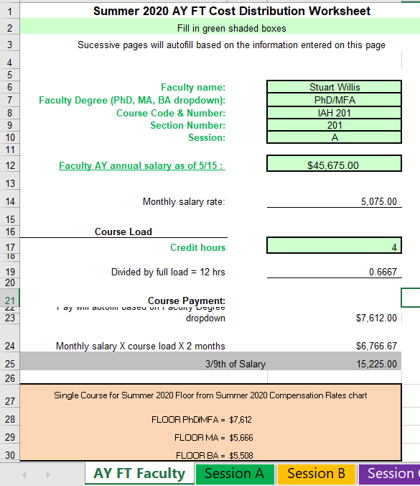
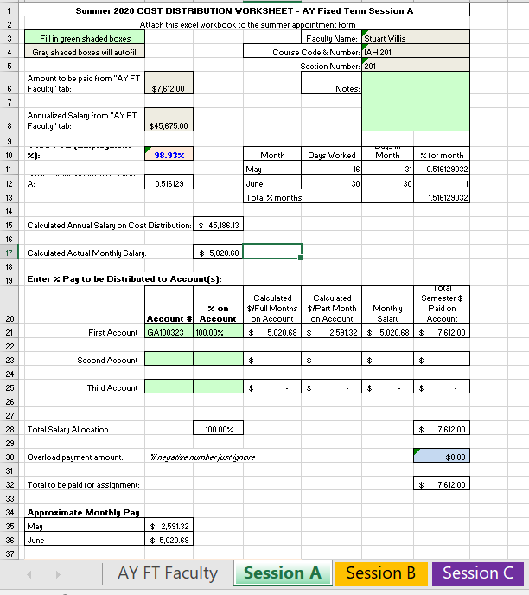
When you fill in the FAS information on the AY FT Faculty tab… the Session tab autofills

Slide 23
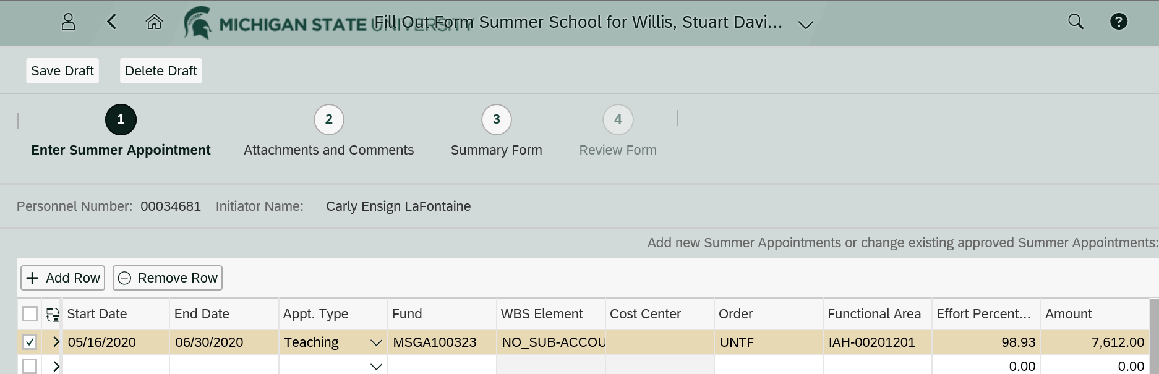
The Effort Percent on the SAP appt form should match the CDW

Slide 24
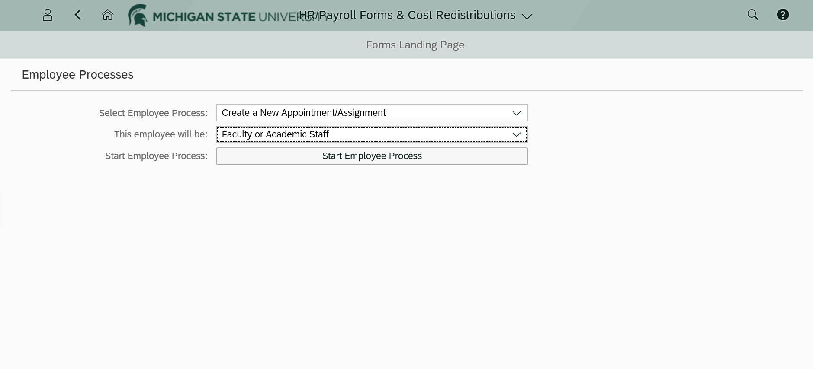
For AN semester-by-semester FAS choose Create a New Appointment/Assignment.
Employee Type is Faculty or Academic Staff

Slide 25
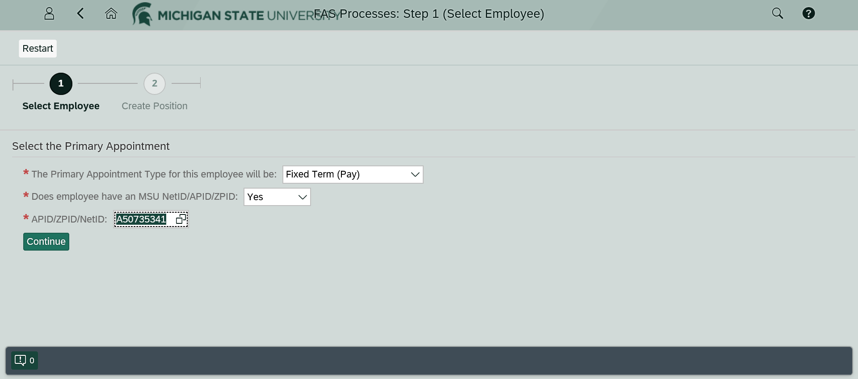
After hitting continue the form will ask for an appointment start date

Slide 26
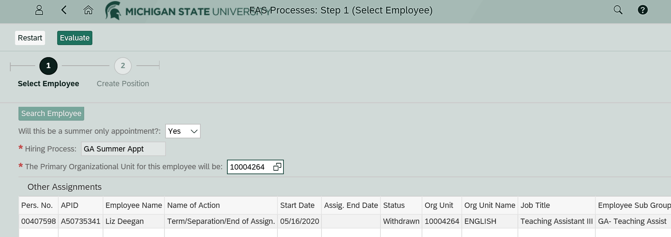
Choose the “Yes” drop down for summer only appointment.
The Hiring Process area is prefilled and unchangeable
The Primary Org is the org code of the unit in which the FAS is being hired.
In this case, the person being hired is an English grad student teaching as a summer FT FAS
Click Evaluate (at the top, not currently showing in the screen shot) and Create Position

Slide 27
Job Title Codes
Based on degree levels:
  20001529 Assistant Professor (has PhD or MFA) $7,612
  20001630 Instructor (has MA) $5,666
  20001521 Assistant Instructor (has BA) $5,508

Slide 28
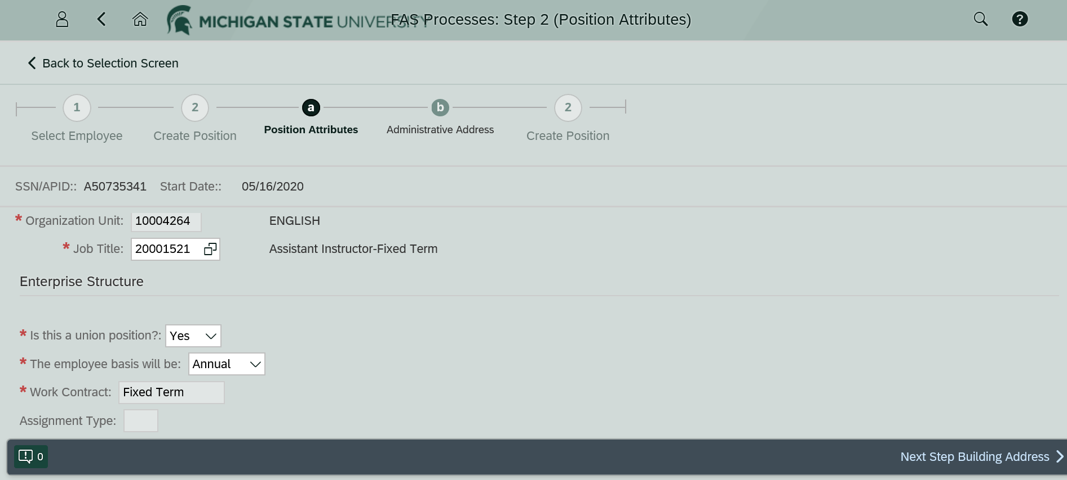
If the FAS is FT and teaching the union position answer is Yes.
For AN appointments the employee basis is Annual
Enter the building code and phone number, if known

Slide 29
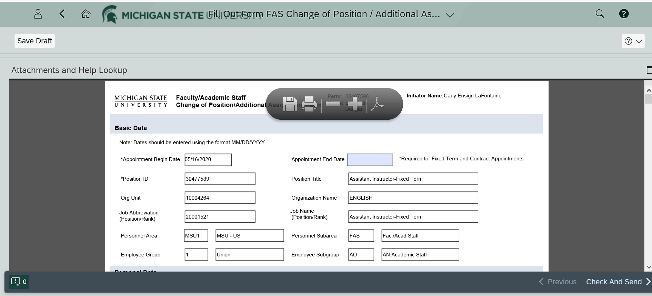
For AY GAs hired as US FT FAS, you might get this terrible form. Sorry!

Slide 30
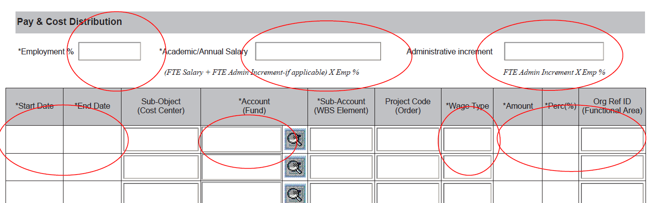
The Pay and Cost Distribution is the most important part of the form

Slide 31
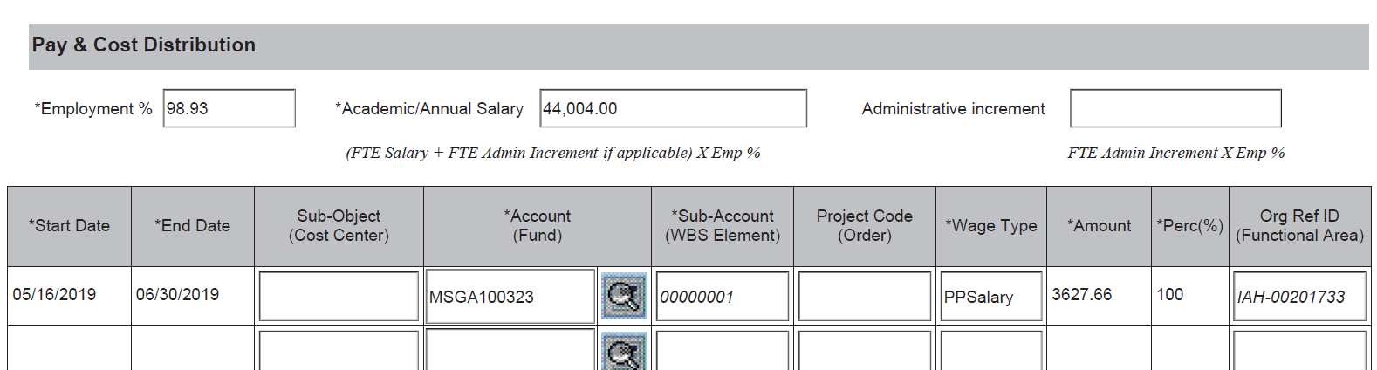
This is an example from last summer

Slide 32
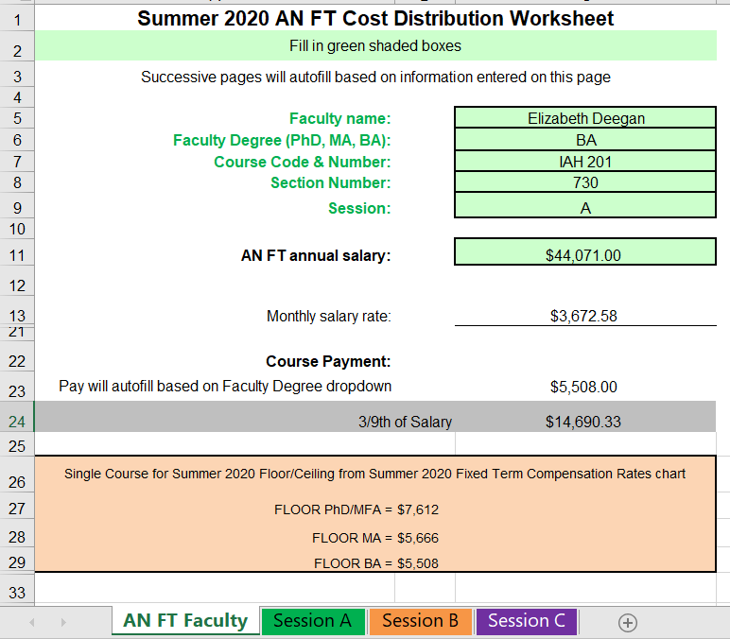
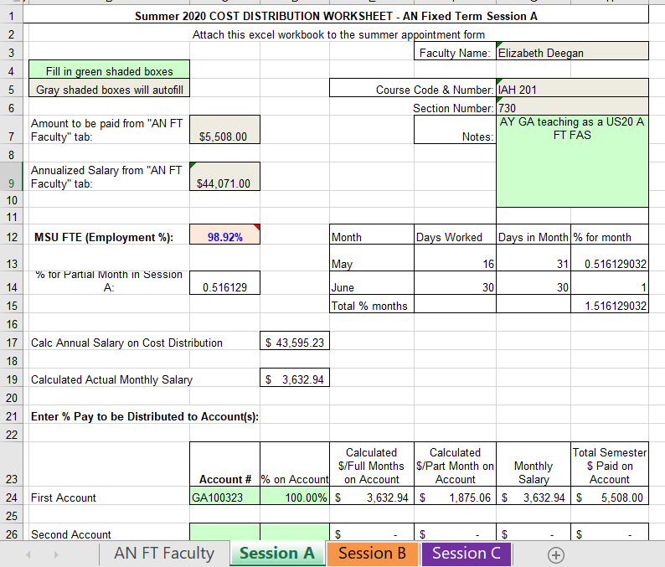

Slide 33
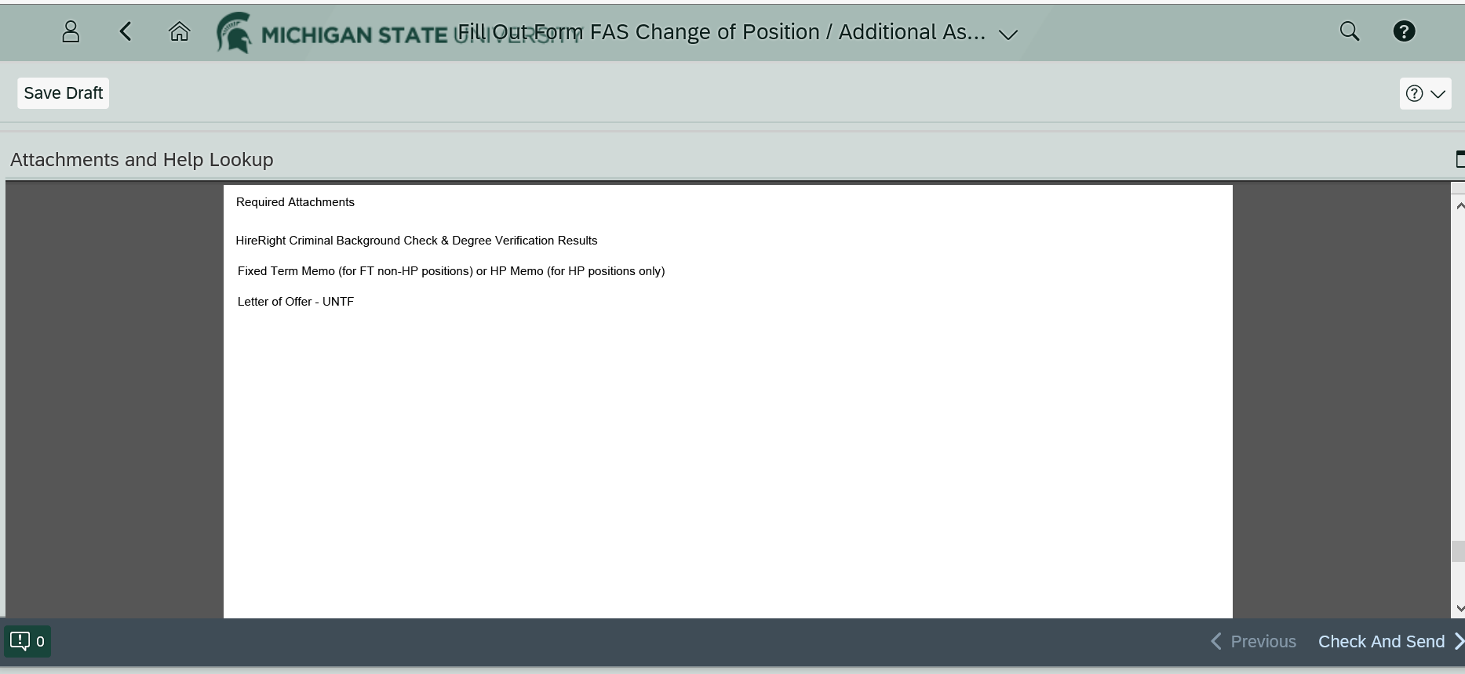
Note the required attachments for AY GAs teaching as US FT FAS

Slide 34
US20 Graduate Teaching Assistantships
The summer GA teaching appointment period is 3 months: May 16 through August 15. These dates are used regardless of whether the TA is teaching session A, B or C
Stipends –
  Level I $1,227 bi-weekly $8,062.85 for the summer
  Level II $1,357 bi-weekly $8,917.71 for the summer
  Level III $1,416 bi-weekly $9,306.27 for the summer
In addition to the stipends, accounts will be charged $2,332 SI (Specific Identification) for each GA

Slide 35
Questions?
The accompanying CAL memo has additional information, including due dates and deadlines
summer@cal.msu.edu (Goes to Carly Ensign and Debbie Richards)
You can start processing summer teaching appointments at any time

